Slide 1



Session 5: Mobile SEO

Slide 2
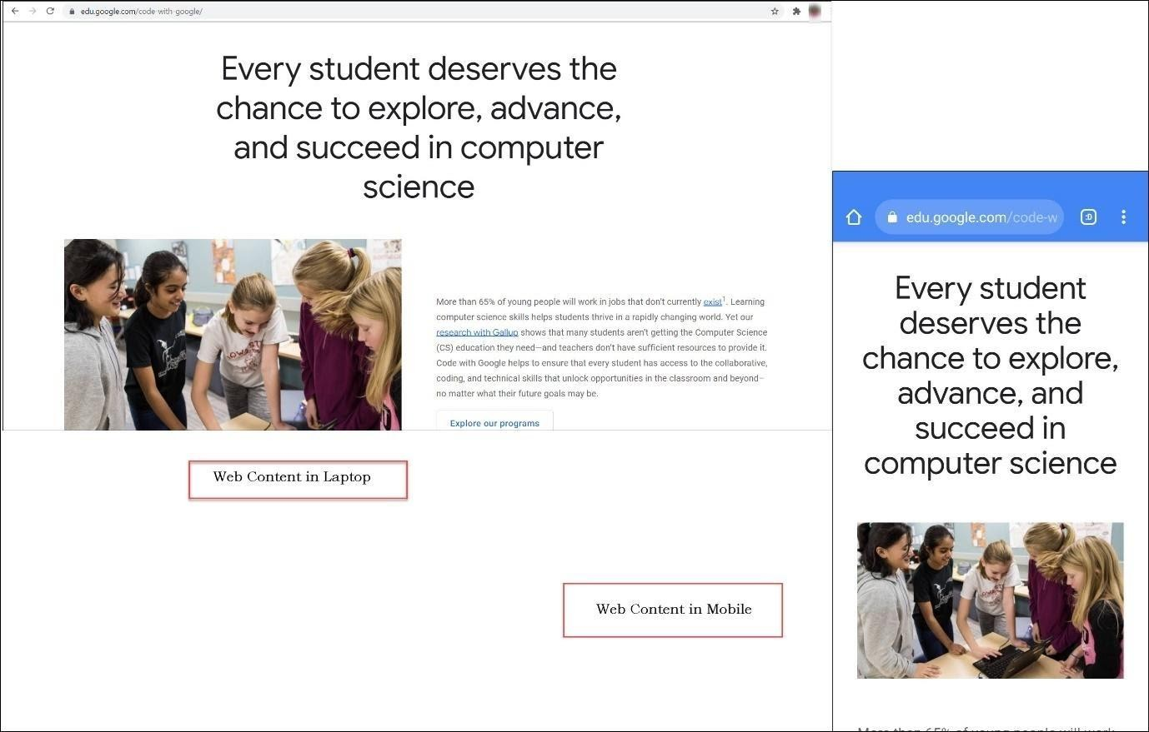
Mobile SEO
Responsive Web Design – An Example
Image Courtesy: https://edu.google.com/

Slide 3

Factors Affecting Mobile Rankings
Positive Factors
Negative Factors
Accelerated Mobile Pages
Crawl Errors
Compressed Images
Too many ads
Example of Intrusive Interstitial
Mobile-friendly Keywords
Small Fonts
Intrusive Interstitials
Social Signals
Small Touch Elements
Local SEO

Slide 4





Mobile Sitemap

Slide 5















Points to Remember for Mobile SEO
Same content for desktop and mobile
Meaningful headings
Same structured data for desktop and mobile
Same page titles and meta descriptions for desktop and mobile
Ad standards be followed
Images on the mobile follow best practices
Supported format for images and videos Same structured data for videos as the desktop
Videos placed in an easy to find position Robots.txt directives to be
checked

